Slide 1
5CS024 – 7CC002 Sprint 1 Towards the Build

Slide 2
Sprint 1
Should now have:
Team
Project
Estimated content for MPV
Idea of needs (Tools, Research etc)

Slide 3
Agile Ideas
https://agilemanifesto.org/principles.html:
“…early and continuous delivery of valuable software”
“Working software is the primary measure of progress.”
“Deliver working software frequently, [...], with a preference to the shorter timescale.”

Slide 4
Agile Ideas
Should now have:
Team
Project
Estimated content for MPV
Idea of needs (Tools, Research etc)

Slide 5


Incremental Development
Getting to our first build
Initial engineering and design decisions
Establish basic scope
“Working Software” however simple
Framework to build on and add features to

Slide 6
Design Choices
Web Application?
Mobile Application?
Programming Language(s)?
Software Patterns/Frameworks?
What is our “Hello World”?
Can we see scope for expansion?

Slide 7
Team Choices
Who needs to be involved?
Information gaps (Training plan)
Have we the right tools? (Source Control? Build?)
Supporting roles? (Testing?)
Identifying any sub-tasks (Splash Screen?)

Slide 8
Splash page
Graphic identity
Loading screen
Basic interface
Example:

Slide 9
Programme (7 Weeks)
First Build?
4
10

Slide 10
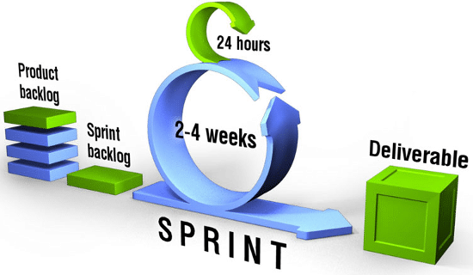
Scrum

Slide 11
Innovation Funnel and the Sprint
Things you are considering
Review existing tasks
Any changes that you need to make
New tasks?
Changes to priority?
Task merge/split?
Re-estimates on task duration?
Agree responsibilies
Product
Backlog
Things you are working on
Working software features
Sprint
Backlog

Slide 12
Schedule
Week x
Task | Description | Assigned to

Slide 13
Stand-up Meeting
Brief regular meeting lead by PMs
Usually 15-20 minutes max
Each group member should say:
What they did since last meeting
What they plan to work on until the next meeting
Any challenges holding them back

Slide 14
Post Stand-up
Team should determine whether they feel they are overall:
Ahead of Schedule
Behind Schedule
On Schedule
Distressed Unable to move forward without additional advice

Slide 15
Discussion forums
Conversations about roles across groups
PMs should report status (ABOD) each week in Discussions
We will read them but you can respond to each others posts and questions

Slide 16
Discussion forums
Share information around ideas or resources
Good forum for questions
May be useful as evidence of individual contribution

Slide 17
Work this week
Teams should prioritise
Integrating any new members
Working with tools (See Learning plan)
Researching topics (See Learning plan)
Delivering on first builds

Slide 18
Project Manager
Key concerns
Co-ordinating tasks for build
Identifying tasks for this sprint
Mapping training tasks
‘Velocity’
All hands on deck

Slide 19
Software Developer
Key concerns
Primary technical decisions (Platform, language(s), tools, frameworks etc
Implementing build
Requesting support if necessary

Slide 20
Embedded Developer
Key Concerns
Same as SD with ED focus
Primary technical decisions (Platform, language(s), tools, frameworks etc
Implementing build
Integration (?)

Slide 21
Business Analyst
Key concerns
Identifying business value
Where next?
Working with DA & SA on interfaces
Considering integration

Slide 22
Database Analyst
Key Concerns
Considering data requirements
Platform and tooling
Considering integration issues

Slide 23
Security Analyst
Key Concerns
Fundamental security issues and risk
Interfaces and integration
Support security implementation

Slide 24
Questions

